Slide 1
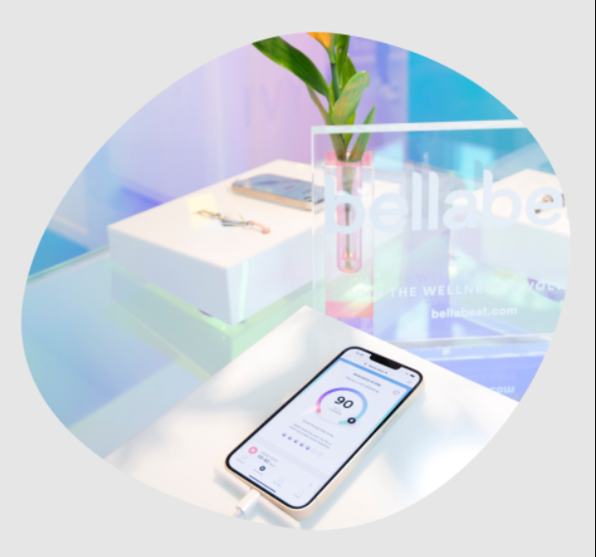
Bellabeat Case Study By Chijioke Anekwe
20th August 2024

Slide 2
Agenda
Project Overview
Business Task
Data Source and Structure
Summary of data preprocessing
Summary of Analysis and key findings
Recommendation

Slide 3
Project Overview
Bellabeat is a high-tech company that manufactures health-focused smart products for women. Since it was co-founded in 2013 by Urška Sršen and Sando Mur, Bellabeat has grown rapidly and quickly positioned itself as a tech-driven wellness company for women. The company has invested in traditional advertising media but focuses extensively on digital marketing. Urška Sršen, the Chief Creative Officer and Cofounder believes that an analysis of Bellabeat’s available consumer data would reveal more opportunities for growth. She has asked the marketing analytics team to focus on a Bellabeat product and analyze smart device usage data in order to gain insight into how people are already using their smart devices. Then, using this information, she would like high-level recommendations for how these trends can inform Bellabeat's marketing strategy.

Slide 4
Bellabeat's Products
Bellabeat app: The Bellabeat app provides users with health data related to their activity, sleep, stress, menstrual cycle, and mindfulness habits. The Bellabeat app connects to their line of smart wellness products.
Leaf: Can be worn as a bracelet, necklace, or clip. The Leaf Tracker connects to the Bellabeat app to track activity, sleep, and stress.
Time: This wellness watch combines the timeless look of a classic timepiece with smart technology to track user activity, sleep, and stress.
Spring: This is a water bottle that tracks daily water intake(hydration levels) using smart technology to ensure that you are appropriately hydrated throughout the day.
Bellabeat membership: Bellabeat also offers a subscription-based membership program for users. Membership gives users 24/7 access to fully personalized guidance on nutrition, activity, sleep, health and beauty, and mindfulness, based on their lifestyle and goals.

Slide 5
Business Task
To analyze smart device usage data in order to gain insight into how consumers use non-Bellabeat smart devices, select one Bellabeat product to apply these insights and make recommendations for Bellabeat marketing strategy.

Slide 6
Data Source and Structure
I used FitBit Fitness Tracker Data for this case study. This is a Kaggle dataset made available through Mobius. It was generated by respondents to a distributed survey on Amazon Mechanical Turk between 03-December 2016 and 05-December 2016. It contains personal fitness tracker from thirty fitbit users. Thirty eligible Fitbit users consented to the submission of personal tracker data, including minute-level output for physical activity, heart rate, and sleep monitoring.
After thorough understanding of all dataset collected, for simplicity, I made use of daily data of activities, weight, sleep and hourly intensity dataset.
Limitation: The sample size is small as only 33 individuals were considered.

Slide 7
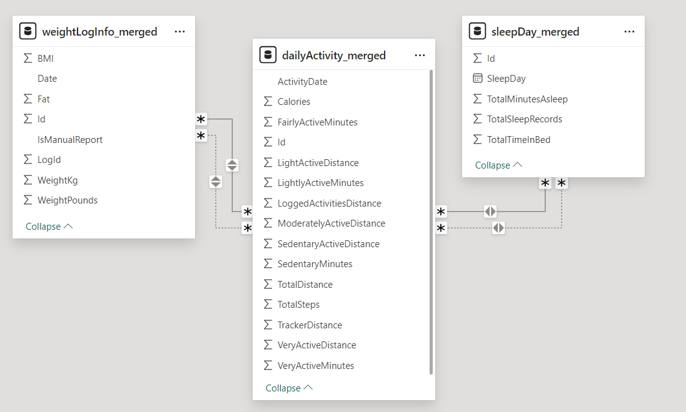
The tables are connected on Id and date columns

Slide 8
Summary of Data Preprocessing
For this Analysis, I used Python to prepare, process and analyze the data.
The date column for all datasets that is in a string format has been renamed and formatted to Datetime.
The Datetime column has been split into date, time and day columns.
Redundant variables like the Fat column in the weight dataset have been dropped.

Slide 9
Summary of Analysis and key findings
The daily average steps taken is 7638 with an average distance of 5.5 km. The majority of the participants take less than 7500 steps per day
The average daily calories burned is 2304 cal.
The daily average of very active and sedentary minutes is 21, and 991 minutes respectively. The daily average sedentary minutes of the participants are very high and need to be reduced, and active minutes need to improve.
The average sleep time is 419 minutes. This is less than 480 minutes of generally recommended sleep time.
The average weight and BMI is 158lb and 25 respectively, however, we don't have enough information to make most of this(i.e, what’s their age? gender? height? etc) and less than 30% of the users (only 8 users) made use of the weight feature.
Most of the participants do not sleep more than 419 minutes or 7 hours.

Slide 10
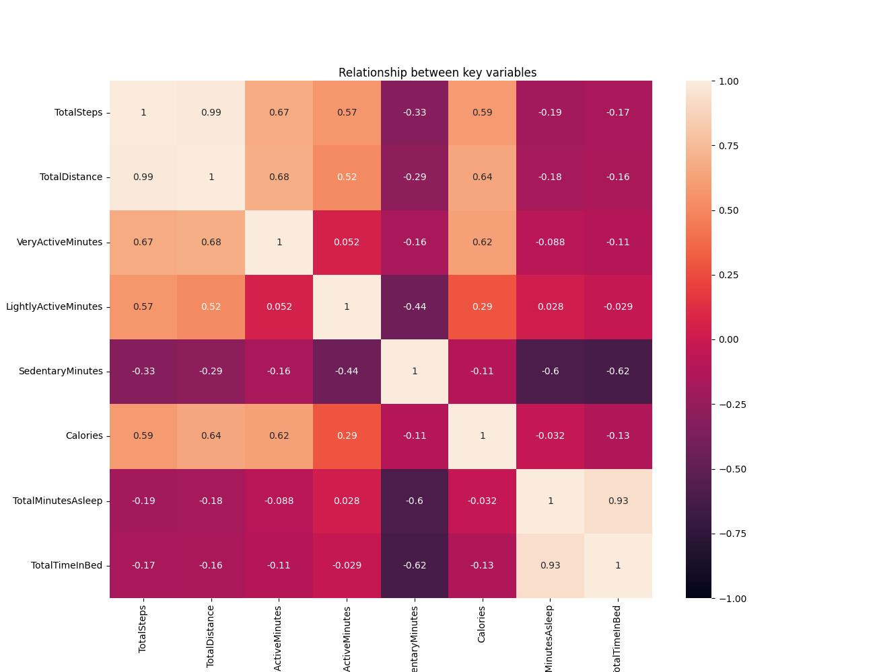
Heatmap plot showing correlation between variables
There is a moderate positive correlation between steps taken , very active minutes and calories burned
Time in bed has a strong positive correlation with minute spent asleep and a very weak negative correlation with number of calories burned.
There is a strong negative correlation between sedentary minutes and the time asleep

Slide 11
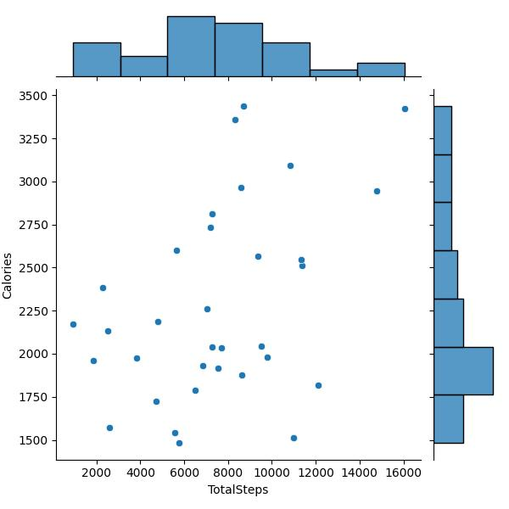
Joint plot showing Correlation between Steps and Calories burned
The Joint chart shows the impact of Steps taken on Calories burned for the 33 participants. There is a direct proportional relationship between the two factors. Participants who took more steps burned more calories

Slide 12
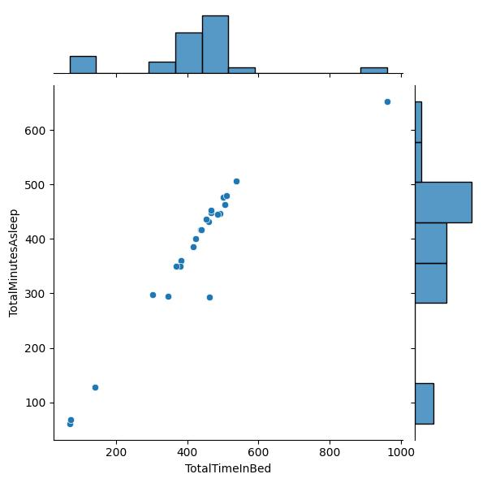
Joint plot showing Correlation between Time asleep, and Time in bed
The Chart illustrates a strong positive relationship between the time participants spend in bed and the time asleep. This means spending time in bed increases one’s chance of sleeping more.

Slide 13
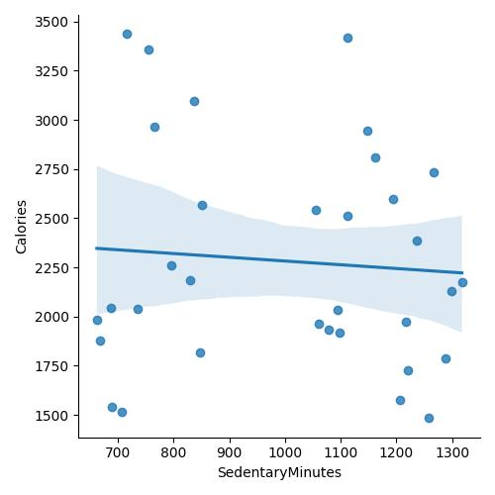
Matrix plot showing Correlation Sedentary Minutes, and Calories burned.
The chart shows that increased sedentary time does not increase the number of calories burned but rather reduces it. More sedentary time can be very unhealthy as it does not burn calories.

Slide 14
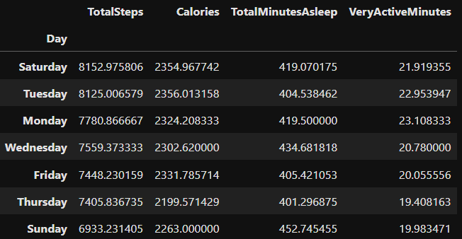
The table below shows days ranked by steps, calories, minutes of sleep, and very active minutes.
The table indicates that participants take more steps and spend more very active minutes on Saturdays, Tuesdays and Mondays than the rest of the days.
We can conclude taking more steps and spending more very active minutes does not improve the daily minutes asleep

Slide 15
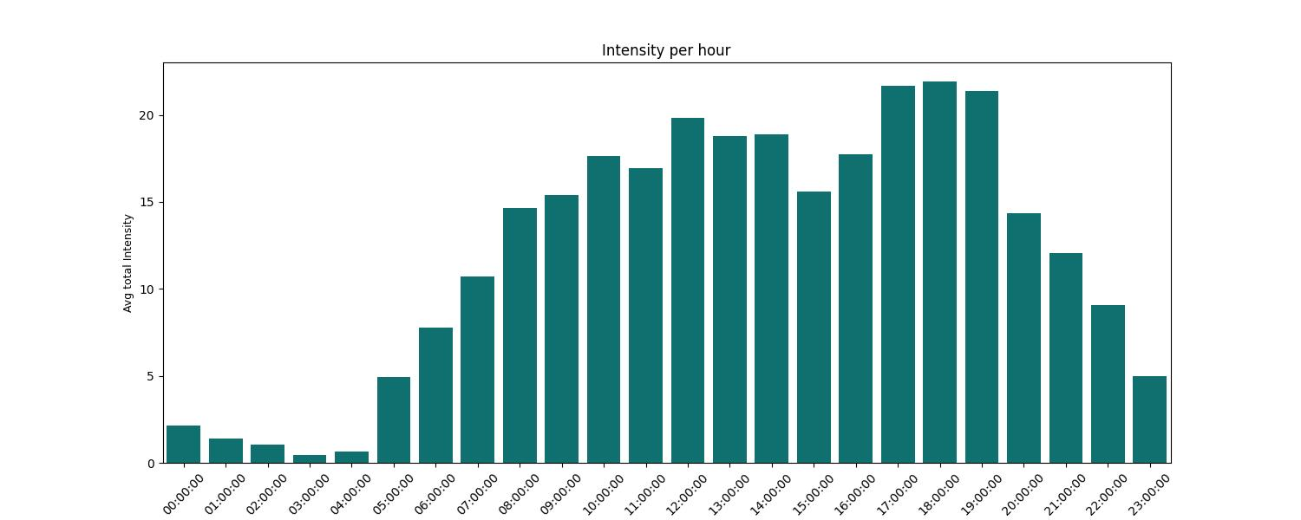
Bar chart showing the hourly trend of intensity
The bar chart above shows the spread of the participants’ lightly to very active hours. The lowest intensities are at the early morning hours when most of the participants are sleeping.
Their peak intensity period is between 5 pm and 7 pm which could indicate after work hours when participants are commuting home, or time at the gym or the time they go to walks/jogging.

Slide 16
Recommendation
Applying the above trends to The Bellabeat's App
Notification on Steps: Sending out notifications within the moderate to high intensity activity hours of the app users to remind and encourage them to take at least 8000 steps (in consideration to CDC research results for young and old people). Along with interesting ideas on how users can fit more steps into their routine.
Notification on Sleep time: Encouraging users to set a sleeping schedule with respect to their personal routines to achieve at least 8 hours (480 minutes) of recommended sleep time and sending out reminders to encourage them to go to bed 3 minutes earlier than their scheduled sleep time since it increases the chances of them falling asleep.
Should not include weight features in their product because most users may likely find it uninteresting or as sensitive information to share.
Tracking and Notification on daily Sedentary time: Sending out notifications on sedentary time to encourage users to limit sedentary time to 8 hours or less per day.

Slide 17
Marketing strategy
The product should be marketed on key features and benefits that users find attractive. (steps taken, burned calories, and sleep )
Targeted messaging, tailored to resonate with different user segment and their goals.

Slide 18
Thank You

